Slide 1

DEPARTMENT OF COMPUTER SCIENCE & ENGINEERING
SCHOOL OF COMPUTING
1156CS701- MAJOR PROJECT
IN-HOUSE
WINTER SEMESTER(2023-2024)
REVIEW - I
“ENHANCING INSURANCE CLAIM INTEGRITY USING MACHINE LEARNING FOR FRAUD DETECTION AND ANALYSIS”
SUPERVISED BY
Dr. S.Lalitha
Associate Professor
PRESENTED BY
Y.Karunkumar (VTU 18059)(20UECS1037)
M.V.Vishnuvardhan (VTU16707)(20UECS0603)
Y.Ramanareddy (VTU 16717)(20UECS1046)

Slide 2
AGENDA
ABSTRACT
OBJECTIVE
INTRODUCTION
LITERATURE REVIEW
DESIGN AND METHODOLOGIES
IMPLEMENTATION
CONCLUSION
REFERENCES

Slide 3
ABSTRACT
Insurance Company working as commercial enterprise from last few years have been experiencing fraud cases for all type of claims.
Amount claimed by fraudulent is significantly huge that may causes serious problems, hence along with government, different organization also working to detect and reduce such activities.
Such frauds occurred in all areas of insurance claim with high severity such as insurance claimed towards auto sector is fraud that widely claimed and prominent type, which can be done by fake accident claim.
So, we aim to develop a project that work on insurance claim data set to detect fraud and fake claims amount.
The project implement machine learning algorithms to build model to label and classify claim.

Slide 4
OBJECTIVES
Aim of the Project:
The aim of the project is to use machine learning to detect and reduce fraudulent insurance claims, particularly in the auto sector, by analyzing a dataset and implementing classification algorithms.
Scope of the Project:
This research aims to identify what are the major determinants of fraud claims and proposed a machine learning solution for detecting fraud claims. Past claim data will be analyzed with underwriting details.

Slide 5
INTRODUCTION
Insurance fraud presents a significant challenge for insurance companies worldwide, resulting in financial losses and higher premiums. Detecting and preventing fraudulent claims is essential for industry integrity and fairness. Traditional methods rely on manual investigation and rule-based systems, limiting adaptability.
Machine learning is a powerful tool for enhancing fraud detection in insurance claims. By analyzing vast datasets, ML algorithms can identify patterns indicative of fraudulent activity. This enables insurance companies to detect fraud more effectively and proactively address complex schemes.
In this paper, we explore the application of machine learning in fraud detection and analysis for insurance claims. We discuss various ML algorithms and techniques that can be employed to detect fraudulent claims, including supervised learning and anomaly detection. Furthermore, we delve into feature engineering, model evaluation, and deployment strategies tailored specifically to the insurance fraud detection domain.

Slide 6
LITERATURE REVIEW
“Machine learning algorithms for fraud prediction in property insurance”, Matheus Kempa, Yaohao Peng, 2021
This paper presents an exploration of machine learning algorithms tailored for predicting fraud in property insurance. It discusses various techniques and advancements in data analysis within the insurance industry, focusing on the application of machine learning models. The paper highlights the challenges of fraud detection in property insurance and proposes innovative approaches to enhance prediction accuracy.

Slide 7
LITERATURE REVIEW
“Insurance Fraud Detection: Evidence from Artificial Intelligence and Machine Learning”,Elsevier , 2022
The project investigates how artificial intelligence and machine learning can improve insurance fraud detection. It examines data to find patterns and anomalies indicating fraud in insurance claims. By comparing different AI and ML techniques, the study aims to enhance fraud detection in the insurance industry, providing valuable insights for insurers and policymakers.

Slide 8
LITERATURE REVIEW
“Analytical study on fraud detection in healthcare insurance claim data using machine learning classifiers”, A. Jenita Mary and S. P. Angelin Claret , 2022
This paper explores the application of machine learning classifiers in detecting fraud within healthcare insurance claims. The authors investigate various classifiers and evaluate their effectiveness in identifying fraudulent activities within the healthcare insurance domain.

Slide 9
DESIGN AND METHOLOGIES
MODULE 1: Data Collection and Pre-processing
MODULE 2: Training the Model and Implementation

Slide 10
MODULE 1: Data Collection and Pre-processing
Determine the specific data attributes needed for fraud detection in insurance claims, such as claim details, policyholder information, transaction history, etc.
Data Collection: Collect comprehensive datasets from reliable sources containing information relevant to insurance claims, ensuring data integrity and completeness.
Data Cleaning: Handle missing values, outliers, and inconsistencies in the data. Ensure data quality before proceeding to the next steps.
Feature Engineering: Extract relevant features from the raw data that could help in distinguishing between legitimate and fraudulent claims. This could include variables like claim amount, claim type, policyholder information, claim history, etc.
Data Transformation: Normalize or scale the features to ensure they are on similar scales. Convert categorical variables into numerical representations through techniques like one-hot encoding or label encoding.

Slide 11
MODULE 2: Training the Model and Implementation
Model Selection: Choose appropriate machine learning algorithms for fraud detection. Commonly used algorithms include:
Logistic Regression
Decision Trees
Gradient Boosting Machines (SGD)
Support Vector Machines (SVM)
Naive Bayes
Model Training: Split the preprocessed data into training and testing sets. Train the selected models on the training data.
Model Evaluation: Evaluate the performance of each model using appropriate metrics such as accuracy, precision, recall, F1-score, and area under the ROC curve (AUC-ROC). Tune hyperparameters to improve model performance.

Slide 12
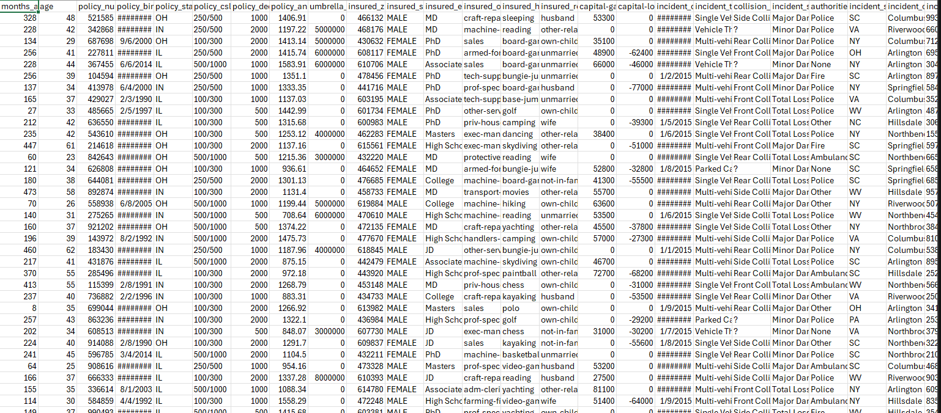
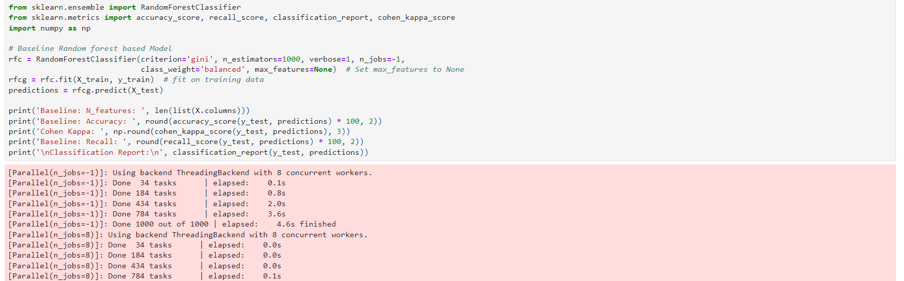
Step 2: Processing of data
Step 3: Apply Machine Learning Algorithms

Slide 13
IMPLEMENTATION
Architecture Diagram
Data –Flow Diagram
Use Case Diagram
Class Diagram
Activitiy Diagram
Sequence Diagram
Colloboration Diagram(If applicable)
E-R Diagram

Slide 14
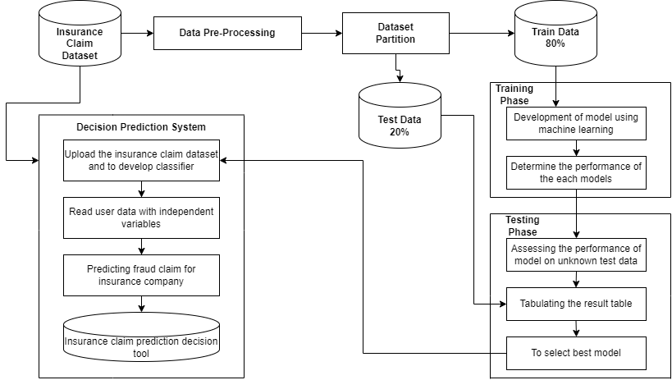
ARCHITECTURE DIAGRAM

Slide 15
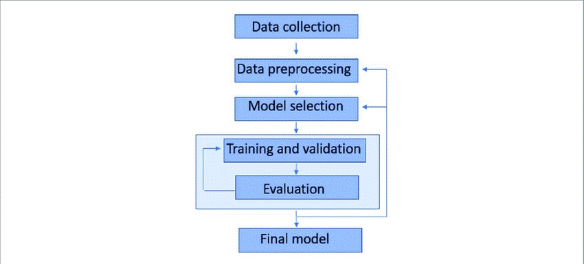
DATA FLOW DIAGRAM

Slide 16
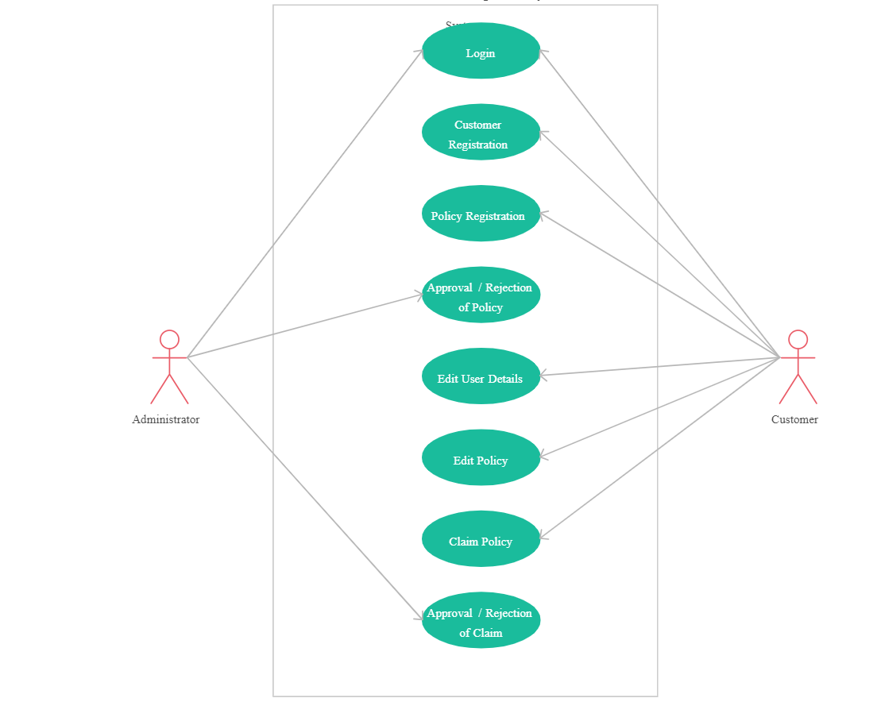
Use Case Diagram

Slide 17
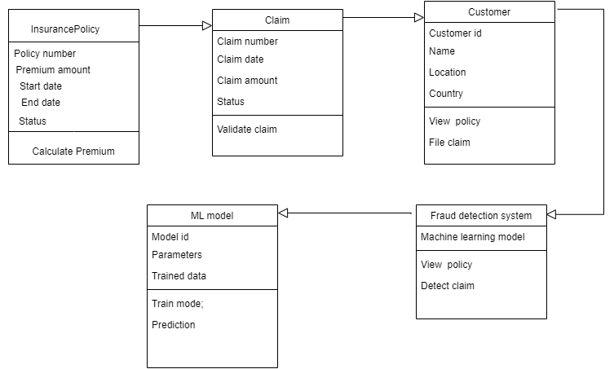
Class Diagram

Slide 18
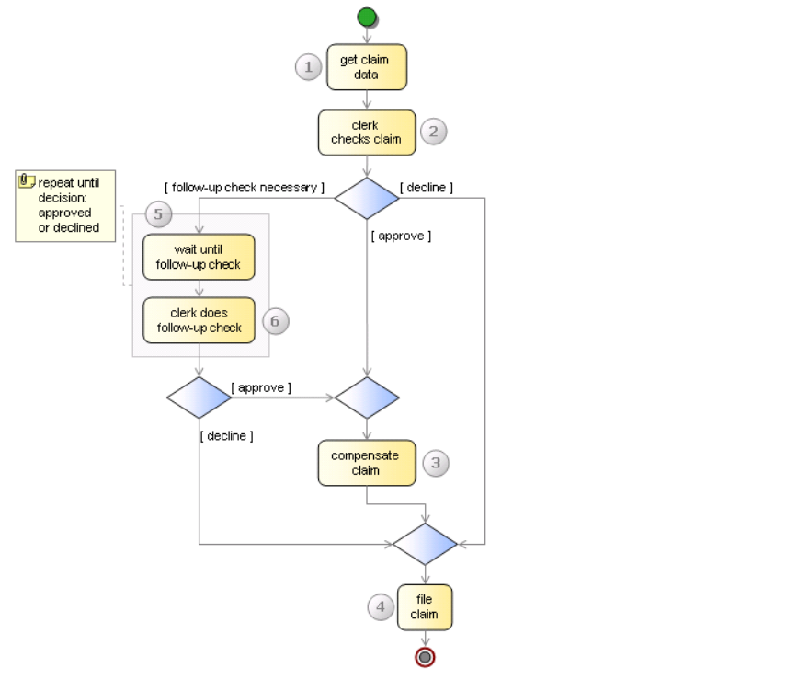
Activitiy Diagram

Slide 19
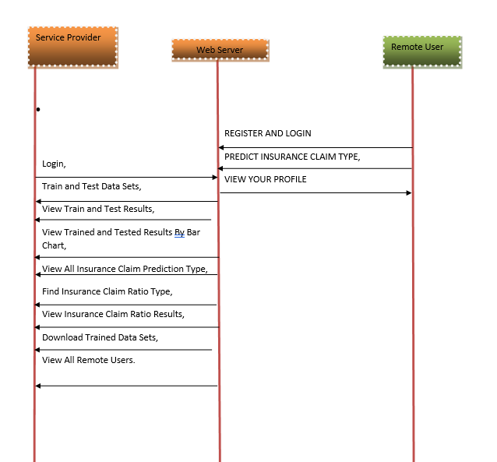
Sequence Diagram

Slide 20
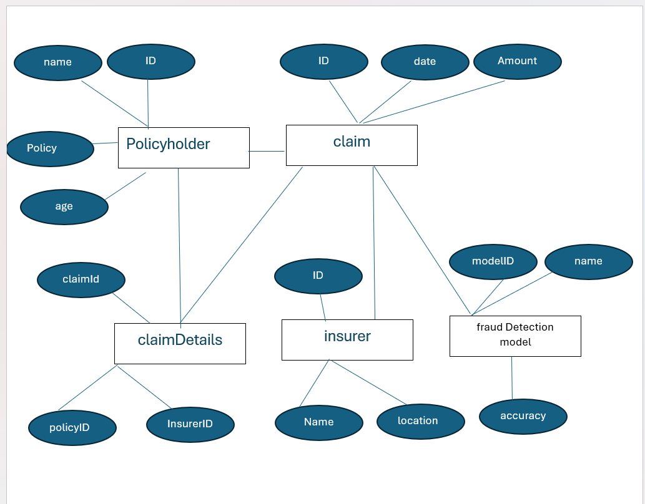
E-r dIAGRAM

Slide 21
REFERENCES
Severino, M. K., & Peng, Y. (2021). Machine learning algorithms for fraud prediction in property insurance: Empirical evidence using real-world microdata. Journal of Insurance Analytics, vol. 5, no. 1, 2021, pp. 45-58.
Elsevier. (2022). Insurance Fraud Detection: Evidence from Artificial Intelligence and Machine Learning. Journal of Insurance Analytics, vol.7,no.3, pp.210-225.
Mary, A. Jenita, and S. P. Angelin Claret. "Analytical Study on Fraud Detection in Healthcare Insurance Claim Data Using Machine Learning Classifiers." Journal of Healthcare Analytics, vol. 8, no. 2, 2022, pp. 145-162.

Slide 22
REFERENCES
Adedayo, F. Adedotun, Oluwaseun A. Odusanya, Olumide S. Adesina, J.A. Adeyiga, Hilary I. Okagbue, and O. Oyewole. "Prediction of Automobile Insurance Fraud Claims Using Machine Learning." Journal of Insurance Analytics, vol. 6, no. 2, 2022, pp. 87-102.
Mary Arockiam, Jenita, and Seraphim Pushpanathan Angelin Claret. "MapReduce-Iterative Support Vector Machine Classifier: Novel Fraud Detection Systems in Healthcare Insurance Industry." Journal of Healthcare Informatics Research, vol. 12, no. 3, 2023, pp. 211-226.
Caruana, Mark Anthony, and Liam Grech. "Automobile Insurance Fraud Detection." Journal of Fraud Detection and Prevention, vol. 9, no. 4, 2023, pp. 301-315...

Slide 23
THANK YOU

